Slide 1
Events and Event Listeners
JavaScript

Slide 2
What is an Event?
Any time a user interacts with a web page, it is said that an event is occuring. An event could be…
The mouse moving inside of the page.
The mouse hovering over a particular element.
A keyboard keypress.
Resizing of the window.
Clicking into (focusing) a form field input.
Change in smartphone orientation.
The scrolling of the page.
One of many other situations!
You can view a full list of event types here.

Slide 3
What is an Event Listener?
JavaScript can detect when events are occuring! If we want our program to react (execute a function) to these events, we must let the browser know to listen for them.
For JavaScript to listen for an event, we use the aptly named: event listener!
The recommended way we implement event listeners is to attach them to elements by retrieving them via the DOM and executing their object’s addEventListener() method.
This method has two parameters. We are expected to pass in the following two arguments…
Type of Event (name as a string.)
Function (to execute when the event is triggered; can be anonymous or a named function.)

Slide 4
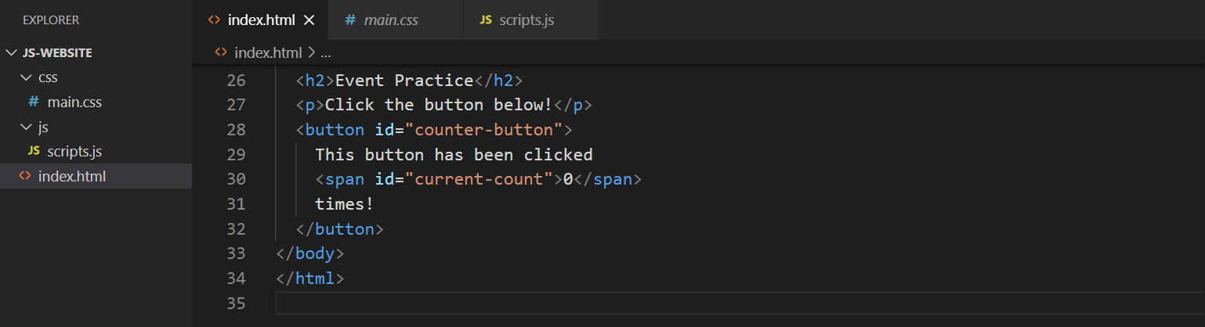
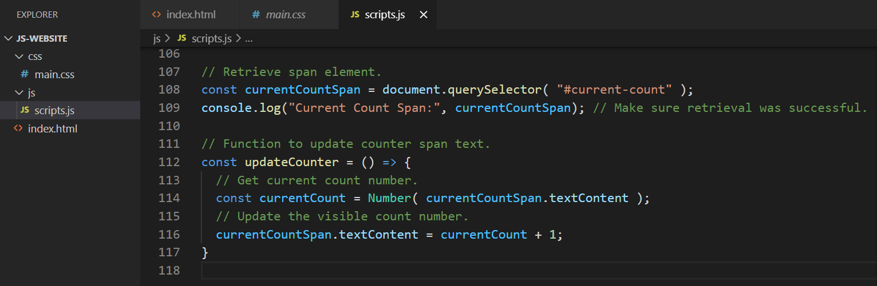
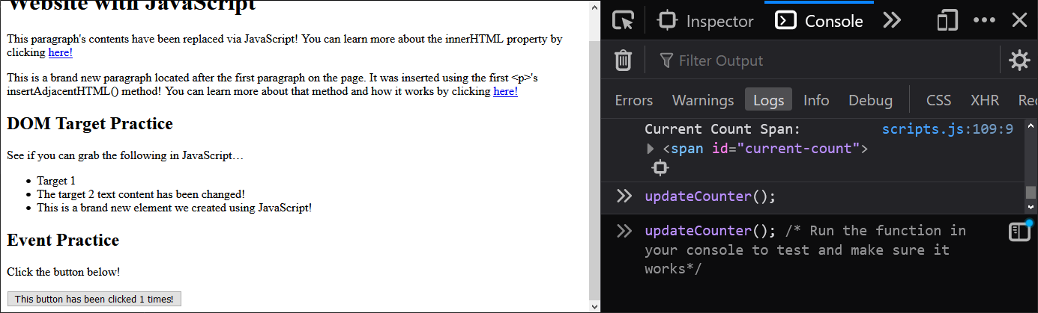
Setting up for an Event Listener
Let’s try a basic event, like clicking a button! For this we’ll need to set a few things up.
Try the following steps…
Add a <button> element to your HTML; ensure it has an ID or class for easy targeting.
Include a span that will contain the number of times the button has been clicked.
Add a function that performs some sort of action on the page; for this example it will be updating a counter.
Test the function via the web console—ensure it is working!
Add an event listener for the button; let it know to run your function when the button is clicked.
Pictured to the right are steps one through four.
Notes:
Index.html
<h2>Event Practice</h2>
<p>Click the button below!</p>
<button id="counter-button">
This button has been clicked
<span id="current-count">0</span>
times!
</button>
Scripts.js // Retrieve span element.
const currentCountSpan = document.querySelector( "#current-count" );
console.log("Current Count Span:", currentCountSpan); // Make sure retrieval was successful.
// Function to update counter span text.
const updateCounter = () => {
// Get current count number.
const currentCount = Number( currentCountSpan.textContent );
// Update the visible count number.
currentCountSpan.textContent = currentCount + 1;
}

Slide 5
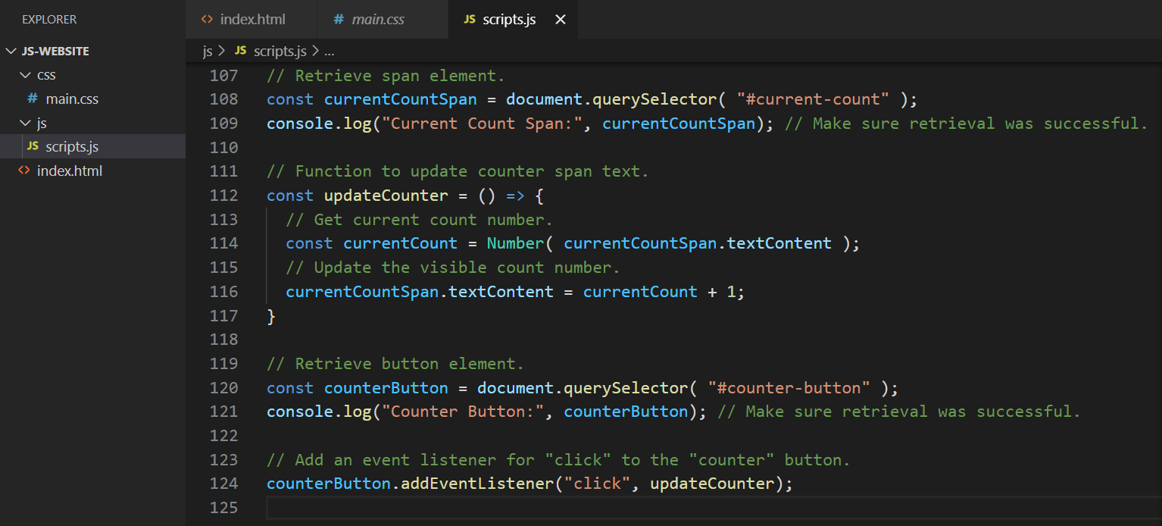
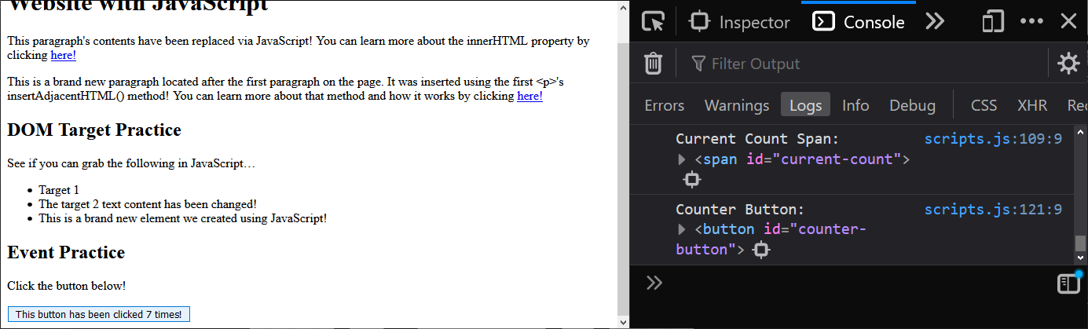

Adding the Event Listener
Time for step five! The user won’t know to use the web console to run our function like we did, so we’ll add a click event listener to the button. Give the following a try…
Use the addEventListener() element method to let JavaScript know we want to assign some functionality to an event.
Notes:
Notice that when we pass our function into the event listener as a callback, we exclude the parentheses.
This is because addEventListener knows to execute it at a later time, it just needs the name of the function.
Remember that when you call a function by name with parentheses, JavaScript will try to immediately execute that function’s instructions. That’s not what we want here! We just want to tell JavaScript which instructions to run if or when the button is clicked.
// Retrieve span element.
const currentCountSpan = document.querySelector( "#current-count" );
console.log("Current Count Span:", currentCountSpan); // Make sure retrieval was successful.
// Function to update counter span text.
const updateCounter = () => {
// Get current count number.
const currentCount = Number( currentCountSpan.textContent );
// Update the visible count number.
currentCountSpan.textContent = currentCount + 1;
}
// Retrieve button element.
const counterButton = document.querySelector( "#counter-button" );
console.log("Counter Button:", counterButton); // Make sure retrieval was successful.
// Add an event listener for "click" to the "counter" button.
counterButton.addEventListener("click", updateCounter);

Slide 6
Form Submit Events
When working with forms (and in some other cases) it can be important to prevent the default outcome of an event.
When you create an HTML form without any JavaScript involvement and submit it, it will deliver you to the page specified in the form’s action attribute (if this attribute is not defined, it will reload the current page with the submission data transmitted.)
When creating a form that interacts with JavaScript, you may not want that default functionality to occur. If you’d like to, instead, carry out instructions of your own design (without reloading the page) instead of a true form submission we can override that default behaviour by use of the preventDefault() event method.
In order to run this method, however, we need to capture the event object for the triggered event and listener. Thankfully, an element’s addEventListener() method passes an event object as an argument to the function you pass in and we can make use of that.

Slide 7
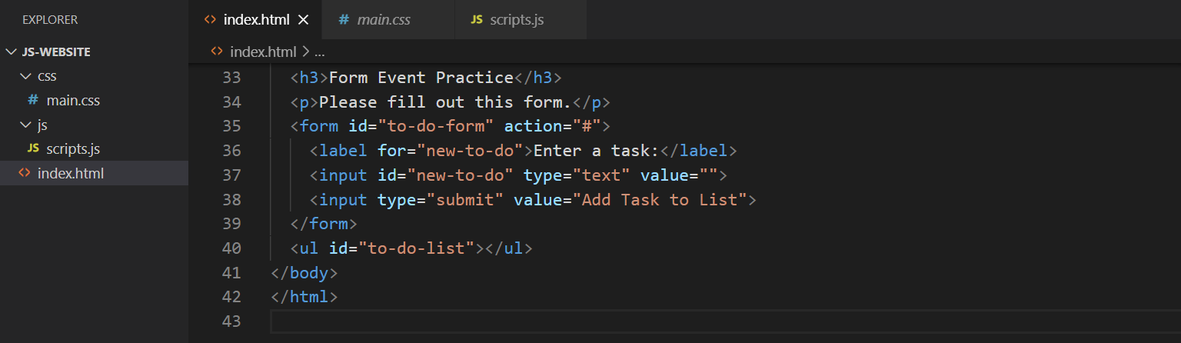
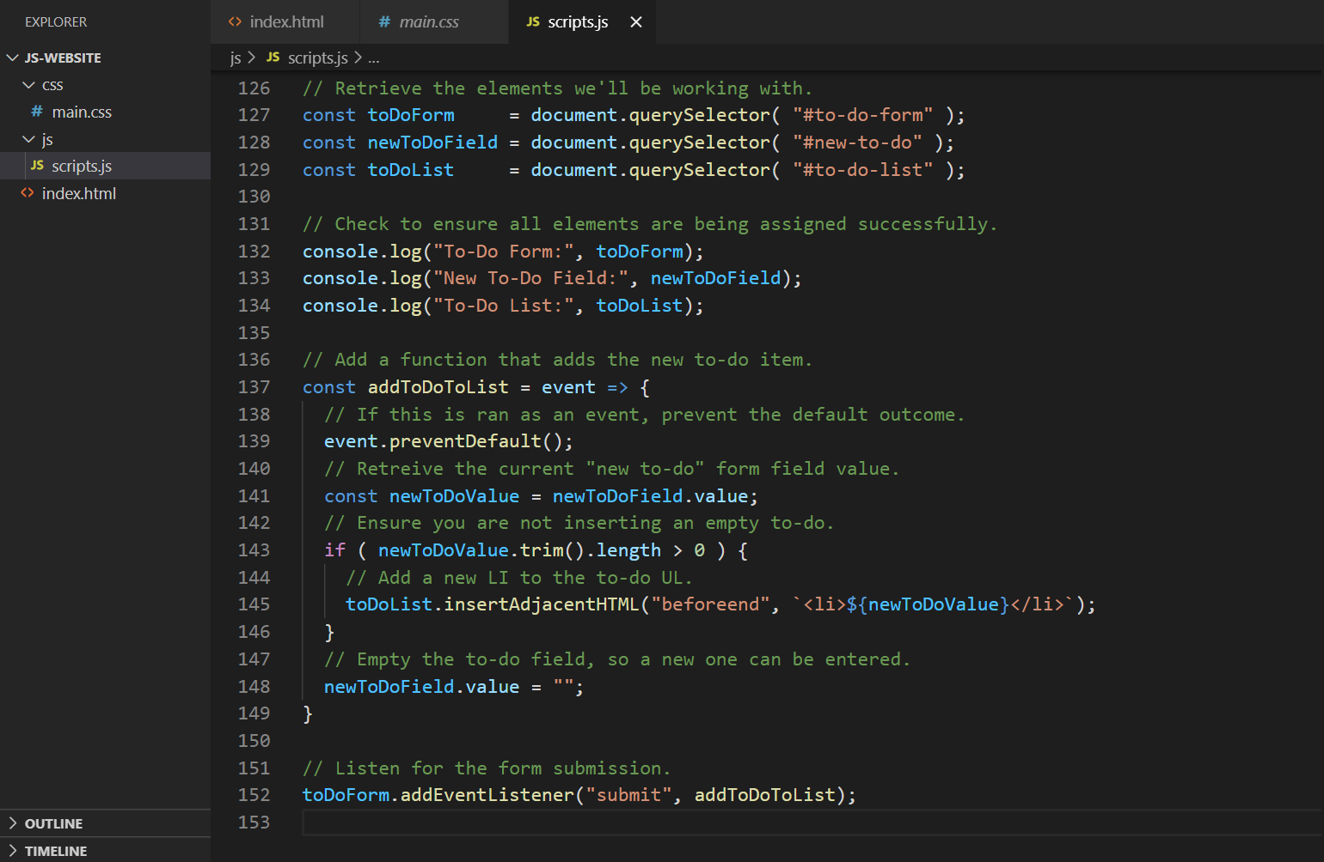
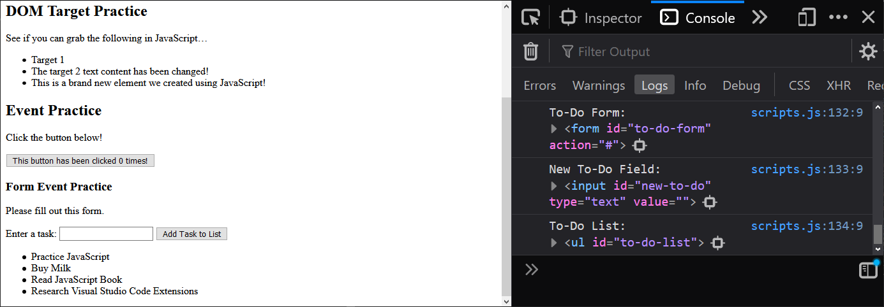
“Submit” Event and preventDefault()
Let’s put together a basic “To-Do Form”. You can type in a task, submit, and in real-time you’ll see it added to a list!
Notes:
Index.html
<h3>Form Event Practice</h3>
<p>Please fill out this form.</p>
<form id="to-do-form" action="#">
<label for="new-to-do">Enter a task:</label>
<input id="new-to-do" type="text" value="">
<input type="submit" value="Add Task to List">
</form>
<ul id="to-do-list"></ul>
Scripts.js
// Retrieve the elements we'll be working with.
const toDoForm = document.querySelector( "#to-do-form" );
const newToDoField = document.querySelector( "#new-to-do" );
const toDoList = document.querySelector( "#to-do-list" );
// Check to ensure all elements are being assigned successfully.
console.log("To-Do Form:", toDoForm);
console.log("New To-Do Field:", newToDoField);
console.log("To-Do List:", toDoList);
// Add a function that adds the new to-do item.
const addToDoToList = event => {
// If this is ran as an event, prevent the default outcome.
event.preventDefault();
// Retreive the current "new to-do" form field value.
const newToDoValue = newToDoField.value;
// Ensure you are not inserting an empty to-do.
if ( newToDoValue.trim().length > 0 ) {
// Add a new LI to the to-do UL.
toDoList.insertAdjacentHTML("beforeend", `<li>${newToDoValue}</li>`);
}
// Empty the to-do field, so a new one can be entered.
newToDoField.value = "";
}
// Listen for the form submission.
toDoForm.addEventListener("submit", addToDoToList);

Slide 8
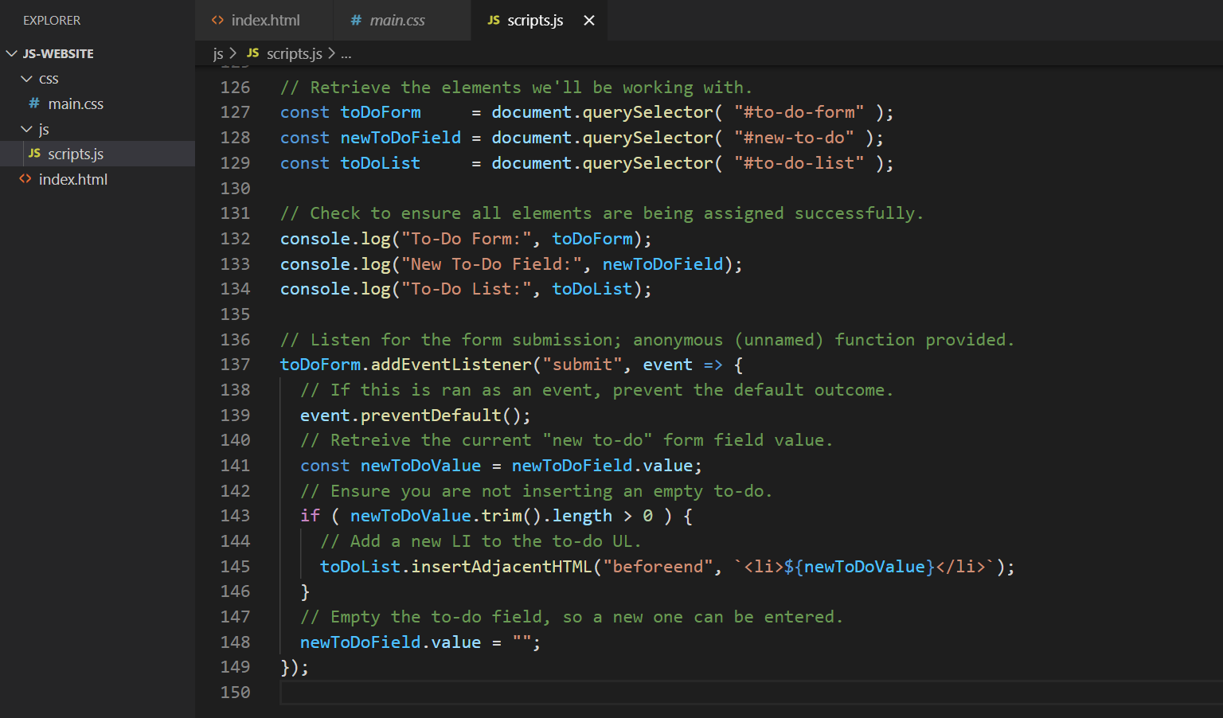
Named Versus Anonymous Functions
This will work exactly the same, but looks a little different! Only use an anonymous function if you know for certain that the same functionality will not be repeated anywhere else in your application.
Notes:
Compare the two versions. The first is a named function, that is later passed into the addEventListener() method as an argument. The second is an anonymous function that is defined directly in the argument field of addEventListener.
Both are valid, but carry their own strengths and weaknesses.
Named functions are re-usable, and often preferred so that you can easily have alternative events or functions trigger your set of instructions. You can even call upon these, if scoped appropriately, from inside of anonymous functions if you’d like!
It is often less typing, if the function isn’t going to be re-used, to go with an anonymous one though—and it keeps everything together with the event it is attached to.
Because of these pros and cons, you’ll see both approaches used across the web. Ensure you’re familiar with both so that you can identify and understand code that you come across in your studies.
// Retrieve the elements we'll be working with.
const toDoForm = document.querySelector( "#to-do-form" );
const newToDoField = document.querySelector( "#new-to-do" );
const toDoList = document.querySelector( "#to-do-list" );
// Check to ensure all elements are being assigned successfully.
console.log("To-Do Form:", toDoForm);
console.log("New To-Do Field:", newToDoField);
console.log("To-Do List:", toDoList);
// Listen for the form submission; anonymous (unnamed) function provided.
toDoForm.addEventListener("submit", event => {
// If this is ran as an event, prevent the default outcome.
event.preventDefault();
// Retreive the current "new to-do" form field value.
const newToDoValue = newToDoField.value;
// Ensure you are not inserting an empty to-do.
if ( newToDoValue.trim().length > 0 ) {
// Add a new LI to the to-do UL.
toDoList.insertAdjacentHTML("beforeend", `<li>${newToDoValue}</li>`);
}
// Empty the to-do field, so a new one can be entered.
newToDoField.value = "";
});

